Slide 1
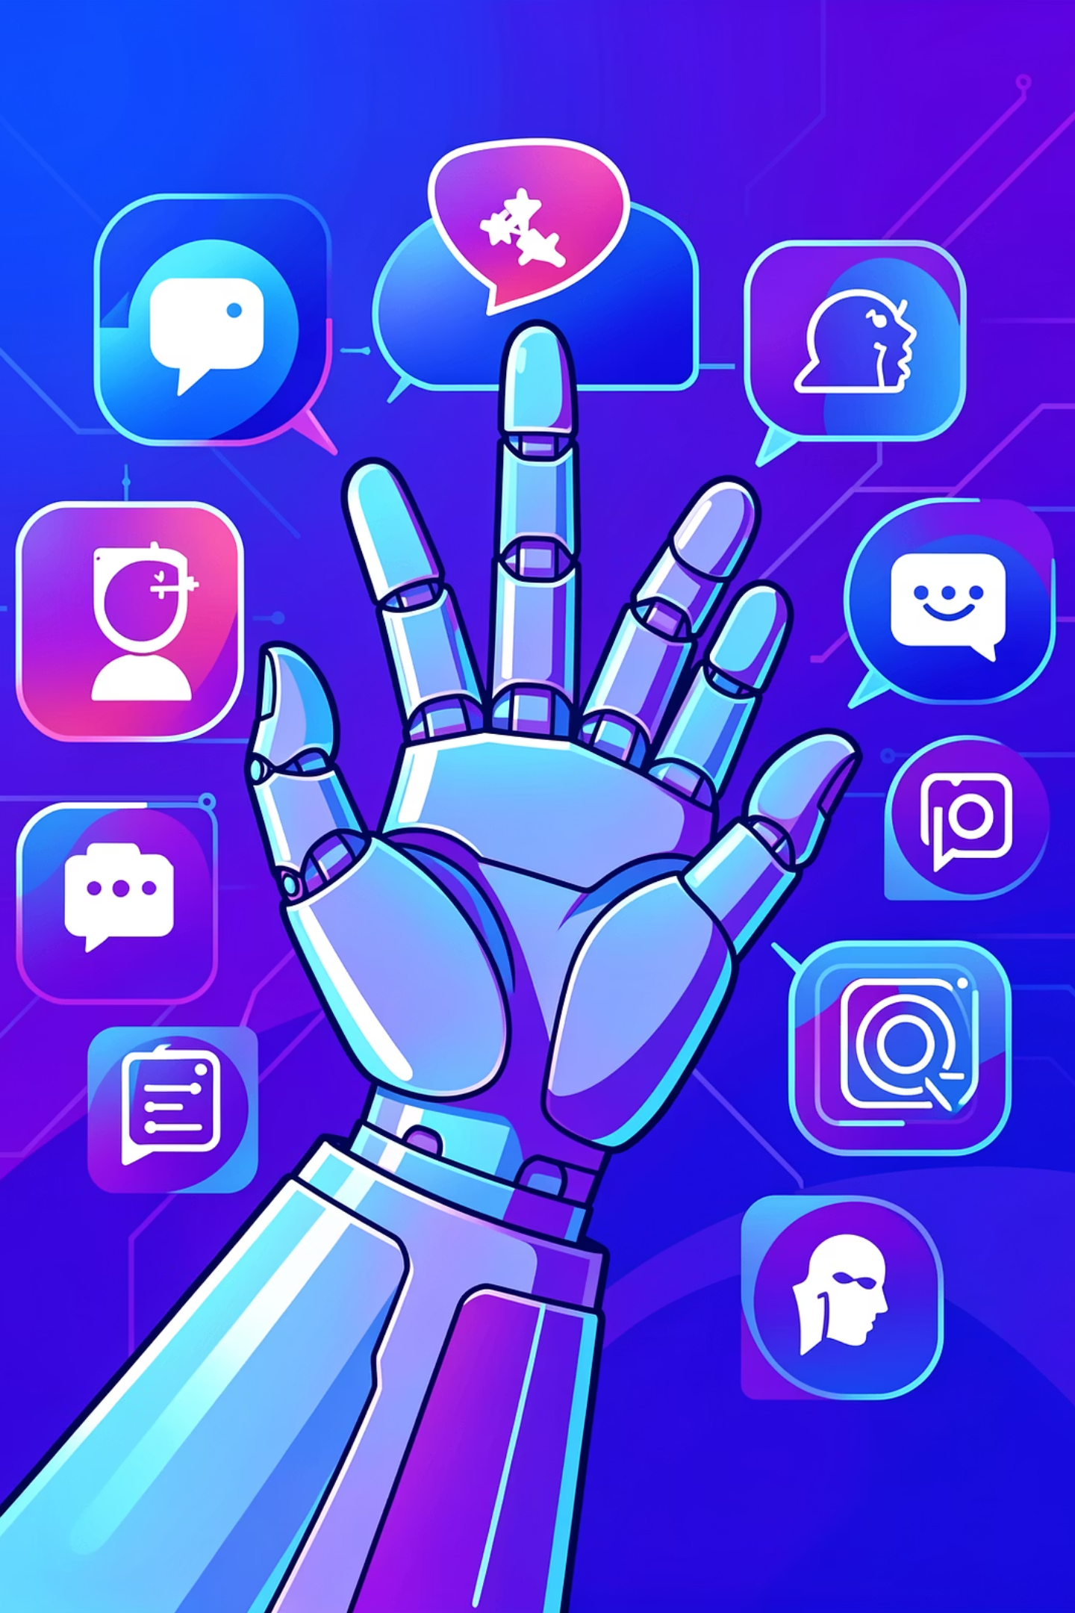
Post Craft AI
Automated, brand-aware social media content creation with human-in-the-loop control.
Crafts realistic, on-brand social media posts

Slide 2


The Social Media Content Challenge
Marketing teams face uphill battles in today's fast-paced digital landscape. From maintaining a consistent brand voice to keeping up with content demands, the struggles are real.
Inconsistent Brand Voice
Time-Consuming Creation
Across diverse platforms, maintaining a unified brand identity is a constant struggle.
Crafting engaging posts for multiple channels eats into valuable marketing hours.
Scaling Content
Risky AI Tools
Events, launches, and campaigns demand high-volume content—a scalability nightmare.
Many generative AI tools ignore crucial brand guidelines, leading to off-brand content.
Generative AI exists, but brand-safe, production-ready social content does not—until now.

Slide 3

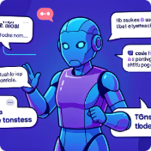
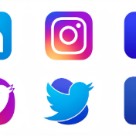

Our Intelligent Solution
The AI Social Media Agent transforms content creation by automating on-brand output, giving marketers their time back.
Learns Brand Identity
Generates Post-Ready Content
Adapts Per Platform
Human-in-Control
Seamlessly adopts your brand's unique voice, tone, and visual aesthetics.
Optimizes content for LinkedIn, Instagram, Twitter (X), and Facebook’s distinct requirements.
Empowers you with full oversight and editing capabilities, ensuring quality and alignment.
Delivers captivating visuals and compelling captions, ready for immediate use.
It’s like hiring a junior social media manager + designer, instantly.

Slide 4



Core Capabilities: Powering Your Brand
Our AI Social Media Agent is engineered with key features that align perfectly with modern marketing needs, ensuring a powerful and effective content strategy.
Brand & Design Understanding
Automated Post Generation
Platform Awareness
Tailors content for each major platform: professional LinkedIn, visual-first Instagram, short & punchy Twitter/X, and community-focused Facebook.
Analyzes brand voice from text, links, and assets. Extracts colors, tone, layout styles, and emoji usage, ensuring visual and linguistic consistency. Integrates logos and icons seamlessly.
Creates complete social media posts including engaging captions, stunning visuals, and clear Calls-to-Action (CTAs). Generates multiple variations per post and optimizes designs for mobile viewing.

Slide 5
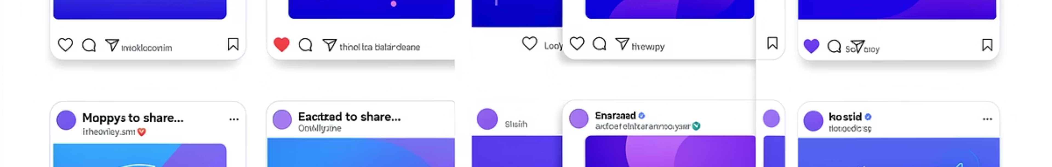
Human-Like Content: The Authenticity Advantage
Our agent avoids robotic AI phrases, crafting content that resonates as authentically human. It's designed for postability, not just demos.
Natural Language Examples:
“Code, design, and ship”
“Meet people who actually love tech…”
“We’re thrilled to reveal…”
This ensures your brand voice is consistently warm, engaging, and indistinguishable from a human marketer's touch. Content feels written by a real marketer, not an AI.

Slide 6


Agentic Self-Feedback Loop: Precision Before Presentation
Our AI doesn't just generate; it refines. Before any content reaches your eyes, it undergoes a rigorous internal review process.
Brand Check
Clarity & CTA
Auto Improve
Readability
This innovative feedback loop mirrors and enhances real internal review workflows, ensuring every piece of content is polished, effective, and perfectly on-brand from the first draft.

Slide 7

Human-in-the-Loop: Empowering Your Creativity
Maintain ultimate control over your content with intuitive editing features. You guide the AI, not the other way around.
1
Caption Refinement
2
Visual Regeneration
3
Fine-Tuning
Manually edit captions or instruct the AI to rewrite text with specific tones or keywords.
Regenerate 4-5 image options (similar to Canva's suggestions), providing diverse visual choices.
Adjust tone, strengthen CTAs, or tweak visuals to perfection, iterating without starting over.
✔️ Full control, zero risk: Your expertise, amplified by AI.

Slide 8
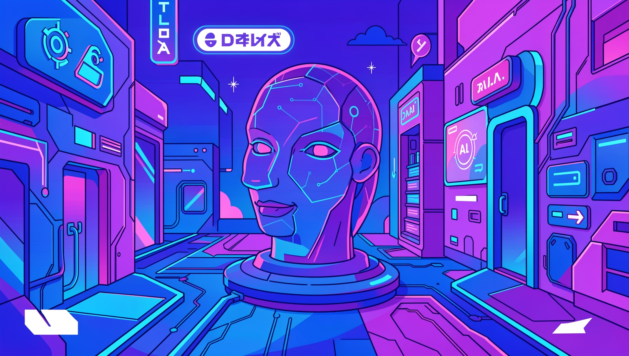
Visual Content Engine: Beyond Generic AI
Our visual engine creates stunning, brand-aligned graphics that stand out in crowded feeds.
Realistic Images: Not generic AI art, but high-quality, relevant visuals.
Brand Colors: Utilizes your exact brand palette, avoiding default shades.
Perfect Placement: Ensures proper logo and icon integration.
Mobile-Optimized: Text overlays are perfectly legible on any device.
Optional Video: Short (3-5 second) video previews for dynamic engagement.

Slide 9


Explainability & Trust: Understanding Every Decision
Transparency is key. Each generated post comes with a clear explanation of the AI's choices, fostering trust and learning.
"This variation uses a friendly tone aligned with the brand’s community-focused style. The image reflects a real hackathon environment using brand colors."
This feature not only builds confidence in the AI's output but also provides valuable insights into effective content strategies tailored to your brand.

Slide 10

Why This Matters: Your Trusted Marketing Copilot
01
Scales Marketing
Expand your reach without diluting your brand identity.
02
Bridges AI & Workflow
Seamlessly integrates AI generation into real marketing operations.
03
Safer & Smarter
Offers a secure alternative to one-shot AI tools with built-in brand safety.
04
Built for Teams
Designed for real marketing teams, moving beyond mere experiments.

